Slide 1


















RATE MY RENT
3RD December 2024

Slide 2
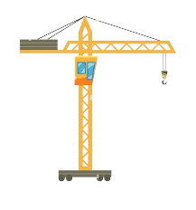


TEAM MEMBERS
Vivian
TEAM DATA UNDER CONSTRUCTION
Omar
Jonathan
Nicolas

Slide 3
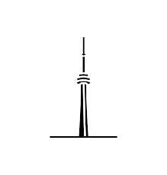



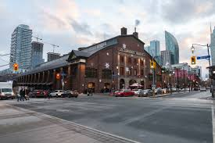
INTRODUCTION
The Challenge:
Canada hosts over 833,000 international students yearly, with 51% in Ontario, many settling in Toronto.
These students often pay 10-20% more due to limited market knowledge.
Lack of access to historical data leaves students vulnerable to overpriced rent.
The Purpose:
Build a model that evaluates rent prices based on key factors like location, size, and amenities.
Help students determine if their rent is fair and avoid being overcharged
Promote transparency in the Toronto rental market.
MORE
EXPLORE THE CITY

Slide 4




FLOWCHART
TRREB
RENTALS.CA
MORE DATA
TRANSFORM
+
EDA
Linear
Regression/
Random forest
ZILLOW
DATA SOURCE
PRE-PROCESSING
MODEL
PERFORMANCE

Slide 5
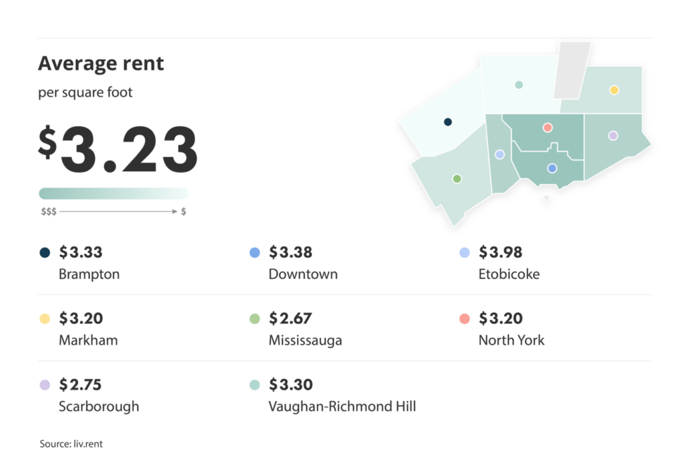
INSIGHT
ALL APARTMENT TYPES (AVG):
RENTALS.CA | $2,642
ONE BEDROOM UNIT (AVG):
ZUMPER | $2,400 (median)
TRREB | $2,513
RENTALS.CA | $2,380
Notes:
100k enrolled students. Around 30% international. (UofT Fall23-24)​
In Q3 2024, rents for one-bedroom units decreased by 5%. (TRREB)​

Slide 6



INSIGHT
Free to access, but not to scrape.
Limited queries
Any bedrooms
Can download data with their browser extension
Only has around 300 data points available for direct download
Free to access: scrape.
Not updated
Only 0, 1, and 1.5 bedrooms.
More than 3.000 Data points
Areas in a range
Free to access: scrape
Updated Data
Had to filter the cities
Any bedrooms
Originally 1000 datapoints, 750 after cleaning.
More confidence by experience.

Slide 7



Data Collect
Limited queries
Clean and merge with Pandas
Neighbor-hood mapping
HTML
4 chunks
CSV
Merge and clean pandas
Geocode
Neighbor-hood mapping
Merge and clean pandas
Geocode API
Neighbor-hood mapping

Slide 8
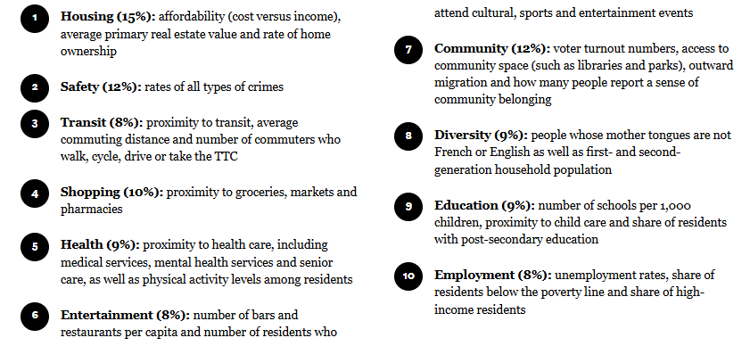
VISUALIZATION
Notes:
Zillow data: low quantity, looks reasonably accurate
TRREB: Good quantity, very flawed and inclusion led to worse model

Slide 9
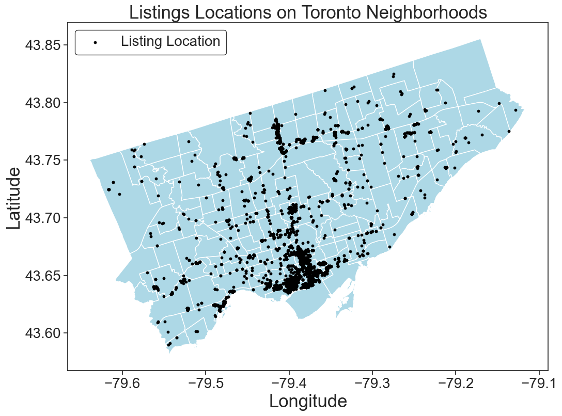
VISUALIZATION
Notes:
Zillow data: low quantity, looks reasonably accurate
TRREB: Good quantity, very flawed and inclusion led to worse model

Slide 10
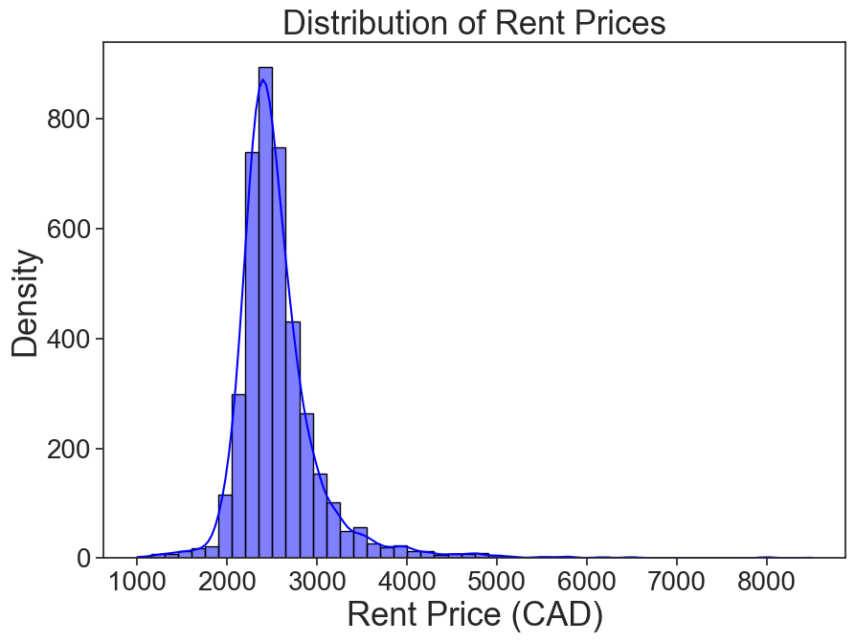
VISUALIZATION
Notes:
Zillow data: low quantity, looks reasonably accurate
TRREB: Good quantity, very flawed and inclusion led to worse model

Slide 11
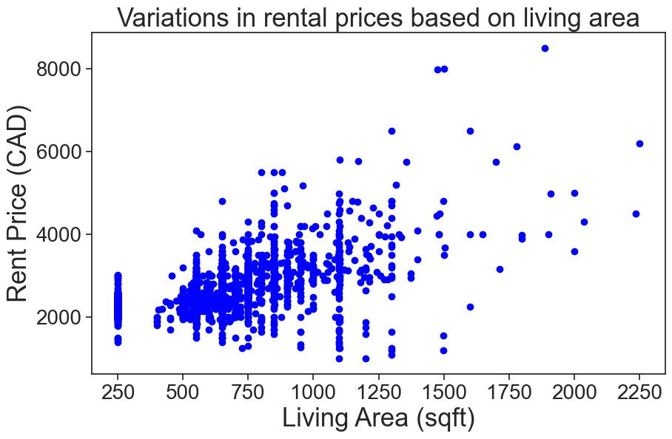
VISUALIZATION
Notes:
Zillow data: low quantity, looks reasonably accurate
TRREB: Good quantity, very flawed and inclusion led to worse model

Slide 12
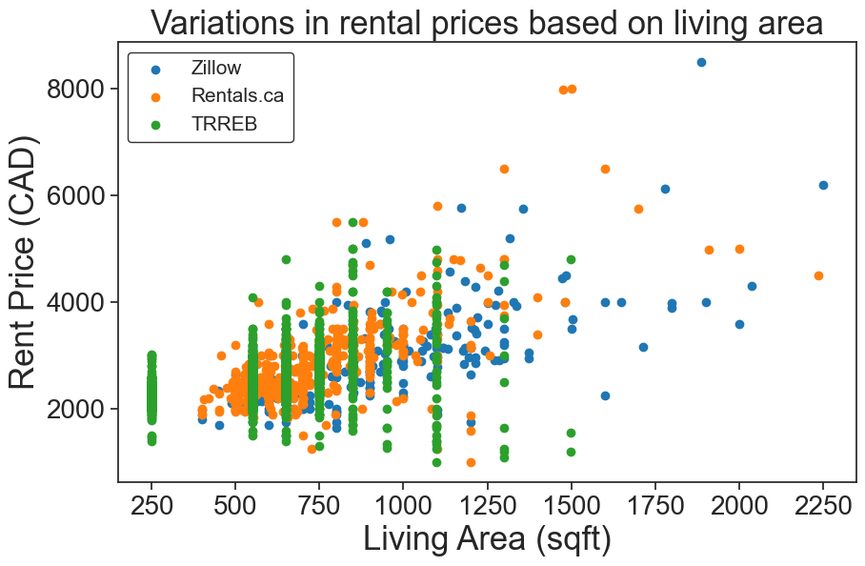
VISUALIZATION
Notes:
Zillow data: low quantity, looks reasonably accurate
TRREB: Good quantity, very flawed and inclusion led to worse model

Slide 13
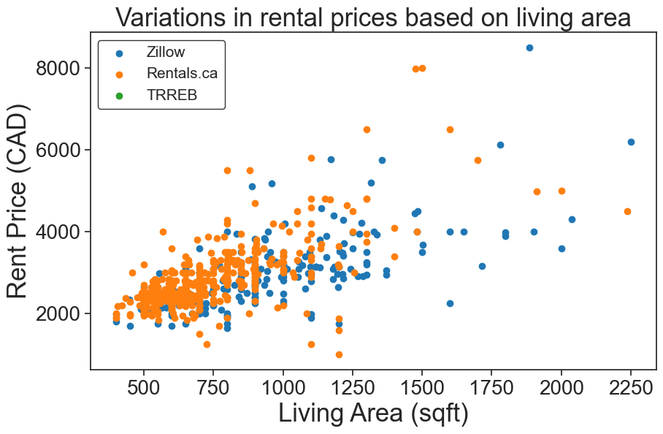
VISUALIZATION
Notes:
Zillow data: low quantity, looks reasonably accurate
TRREB: Good quantity, very flawed and inclusion led to worse model

Slide 14
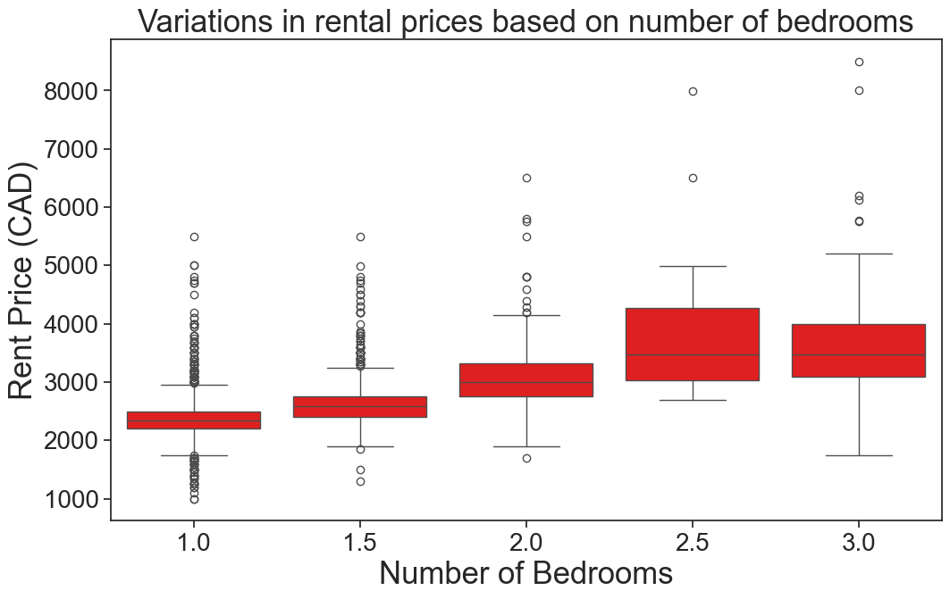
VISUALIZATION
Notes:
Zillow data: low quantity, looks reasonably accurate
TRREB: Good quantity, very flawed and inclusion led to worse model

Slide 15
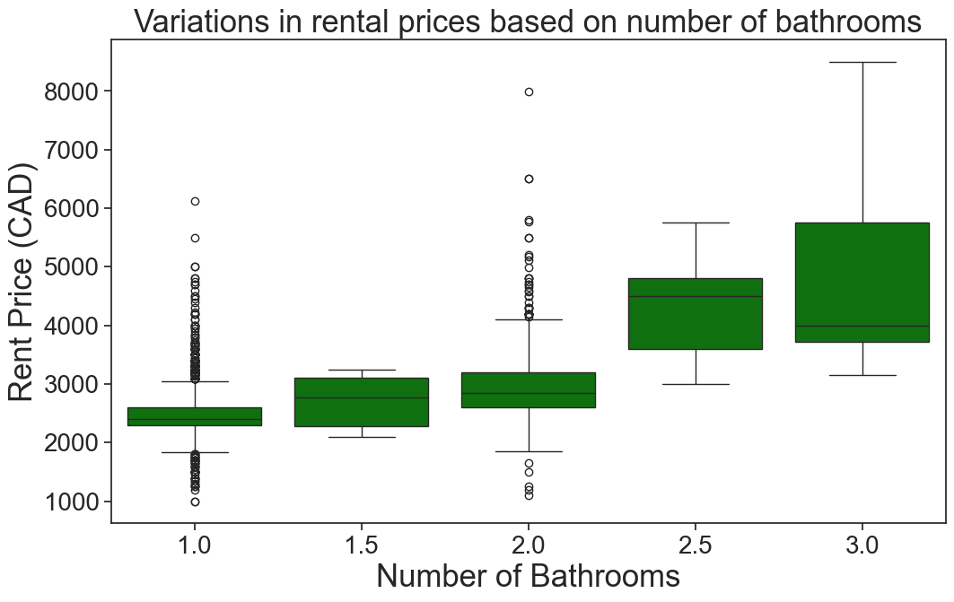
VISUALIZATION
Notes:
Zillow data: low quantity, looks reasonably accurate
TRREB: Good quantity, very flawed and inclusion led to worse model

Slide 16
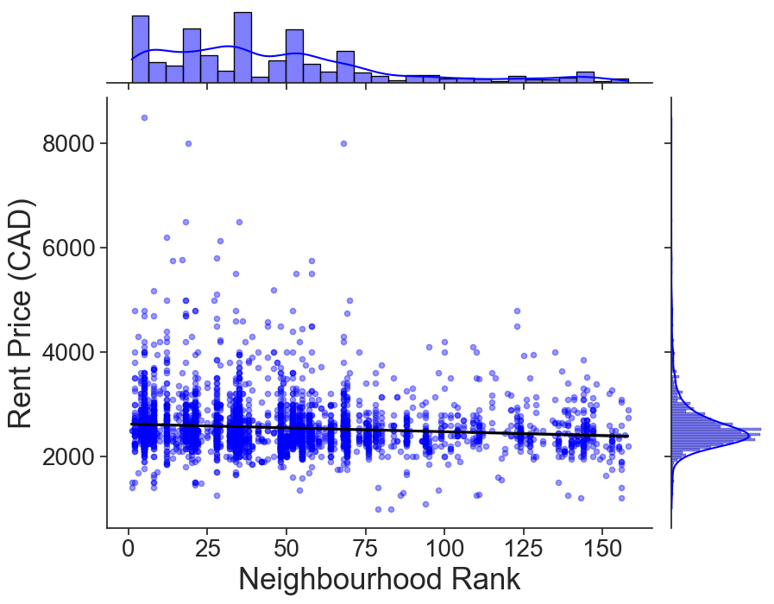
VISUALIZATION
Notes:
Zillow data: low quantity, looks reasonably accurate
TRREB: Good quantity, very flawed and inclusion led to worse model

Slide 17
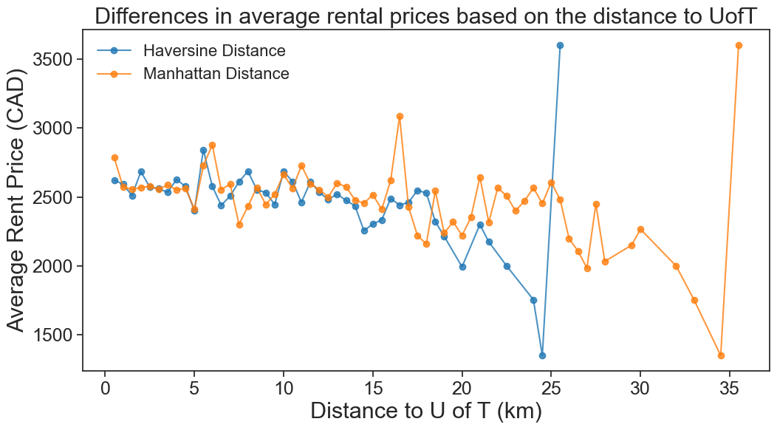

Slide 18
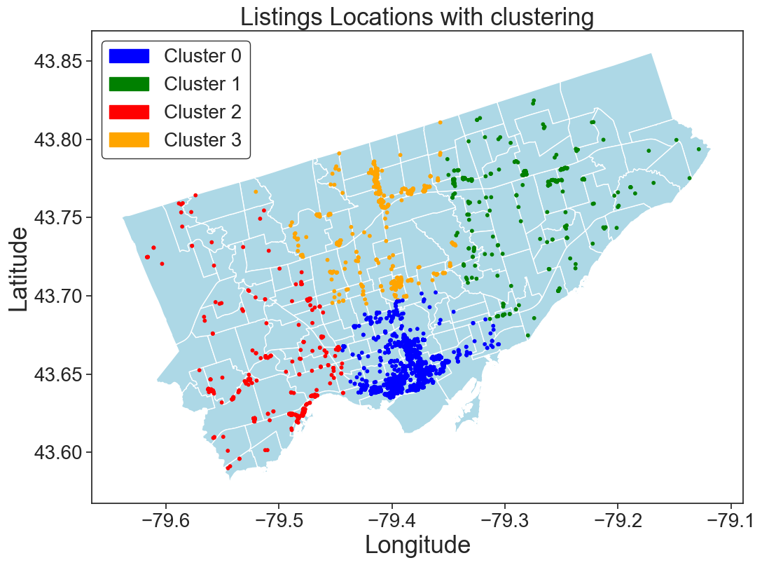
MODELLING (TRAIN, TEST, SPLIT)

Slide 19
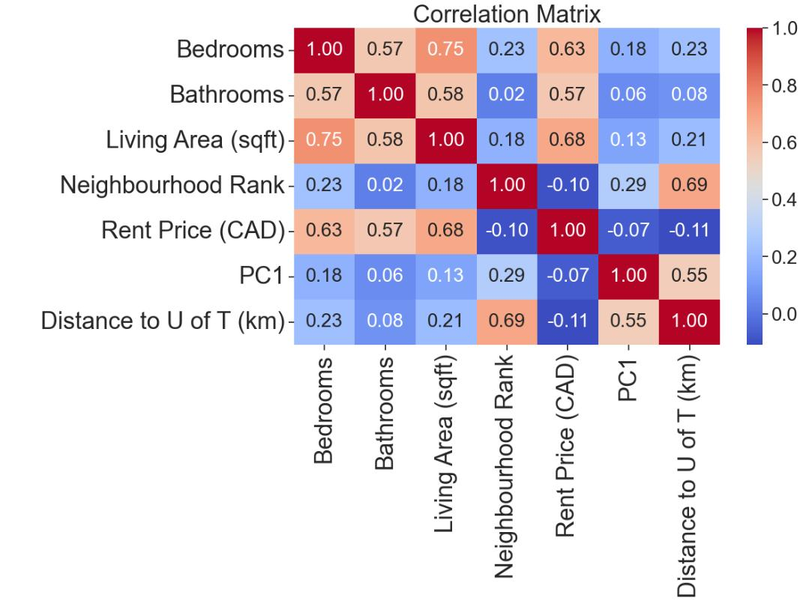
MODEL

Slide 20
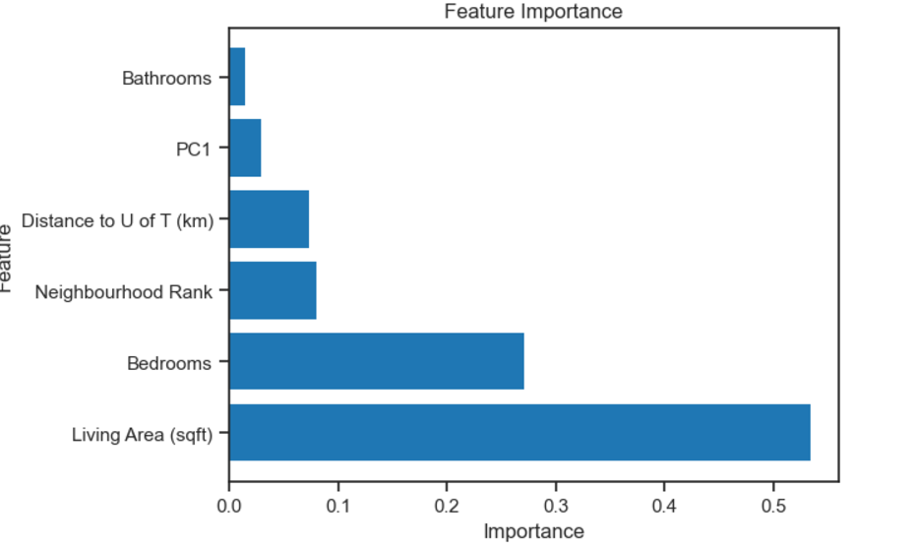
MODEL
Data Preprocessing:
PC1 is generated from latitude and longitude.
All features are scaled using sklearn’s StandardScaler.
Feature Analysis:
Correlation between features and price
Correlation between features.
Feature importance using Random Forest.
Feature importance using permutation analysis.

Slide 21
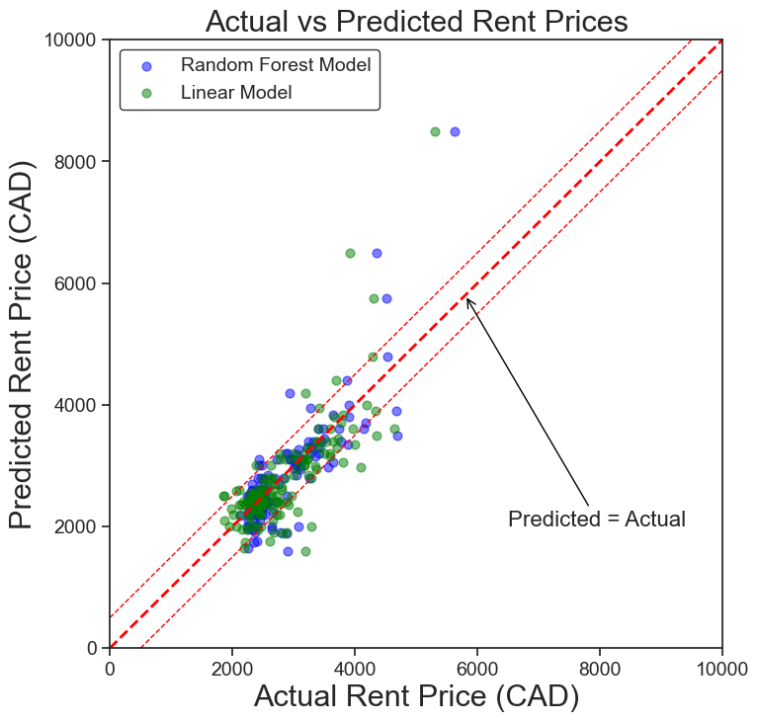
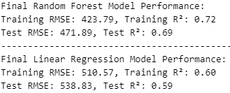
MODEL PERFORMANCE
21

Slide 22
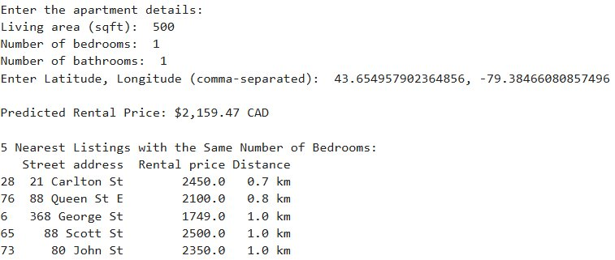
CONCLUSION
An Illustration of an Input function where users can check their expected rent price.
FUTURE WORK
Collect more high-quality data.
Develop a user-friendly website for easy data access, replacing the current input function.
22
22

Slide 23
REFERENCES
Zillow.com
Rentals.ca
TRREB.ca
Toronto Open Data – Neighborhood boundaries - https://open.toronto.ca/
Neighborhood rank - https://torontolife.com/toronto-neighbourhood-rankings/
23
23

